Slide 1




Tinker Quest’24
PRESENT
Team Terox
Satish Kumar Maurya
Kousik Kumar Barnwal
Aditya Kumar

Slide 2


objective
Redcliffe Labs had been facing a problem regarding their Inventory Management System of different components like reagents, tests, and machines.
This problem became more complex when it considered different labs of different locations together.
They had a lack of a very efficient Inventory Management System that tracks item movement, link tests, reagents, machines, labs, and forecast inventory for efficient resource allocation, streamlined processes, and swift issue resolution. We had to solve this problem by creating a web application for it.

Slide 3

Approach
Before creating this web application for the effective management system and accurate inventory demand forecasting, we considered and assumed two types of users in the Redcliffe Labs for this app.
Admin: The administrative head responsible for overseeing multiple labs within a particular region. Lab associates from different labs report to the admin for maintenance and management purposes.
Lab Associate: The direct supervisor is responsible for managing inventory, order tracking, and reporting faults within their specific laboratory.

Slide 4












Technology used

Slide 5
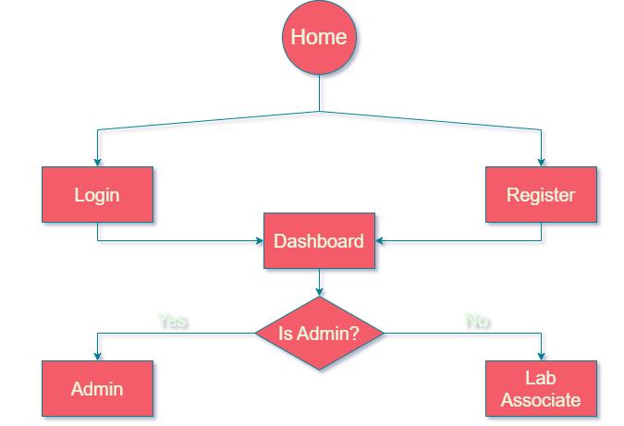
Flow chart

Slide 6
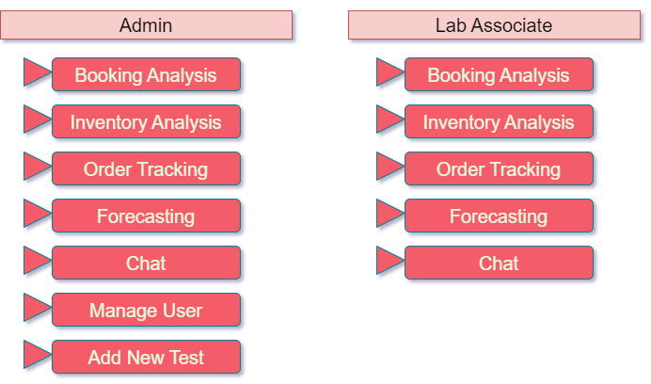

Slide 7
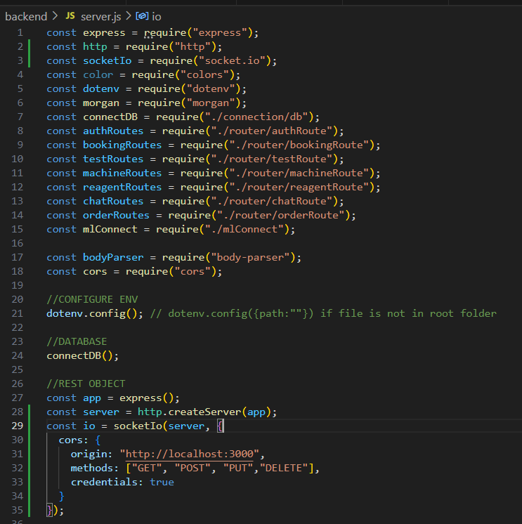
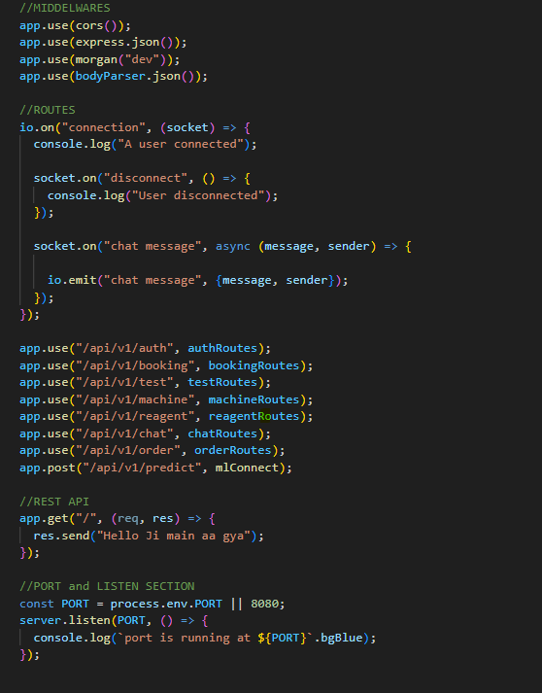
Backend Server.js File

Slide 8
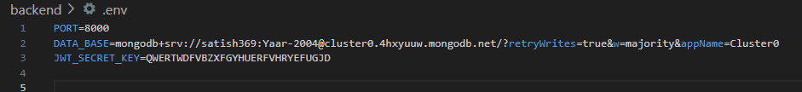
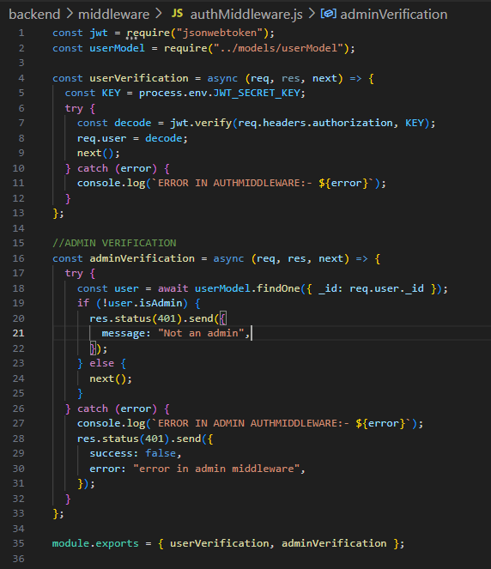
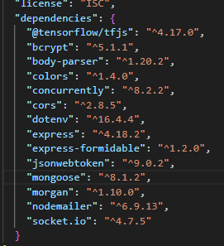
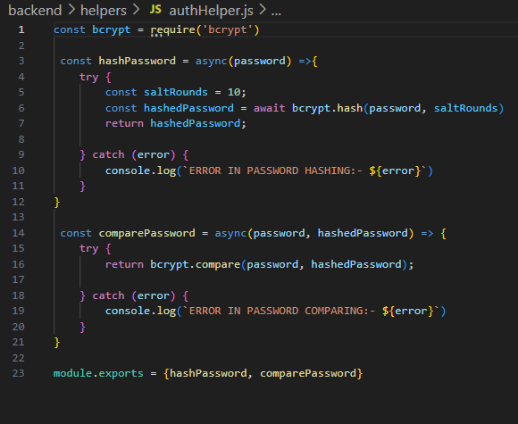
Backend .env file for Protect PORT No., Data Base and JWT Secret key
User and Admin Verification
Backend Dependences
Password Hashing

Slide 9
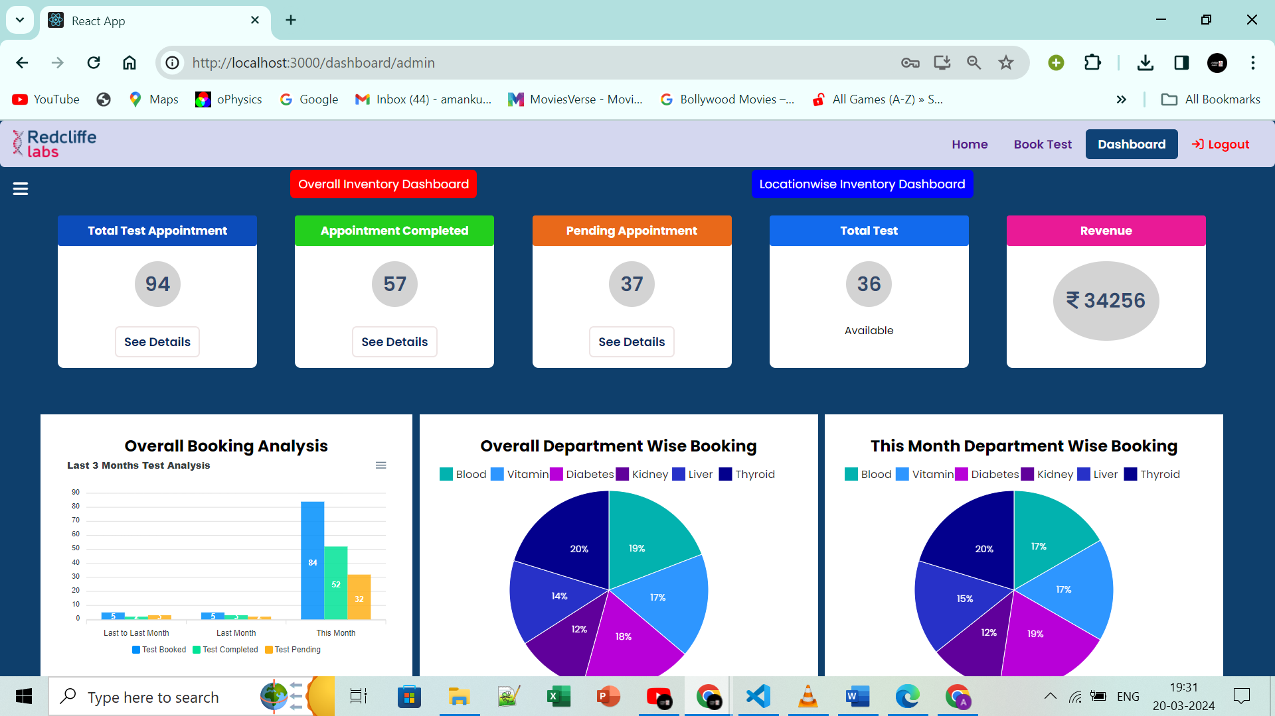
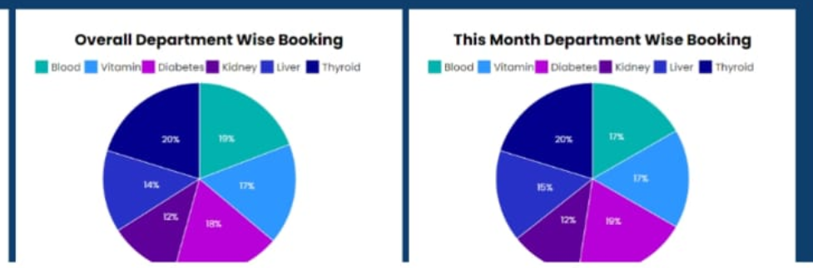
Inventory Dashboard

Slide 10
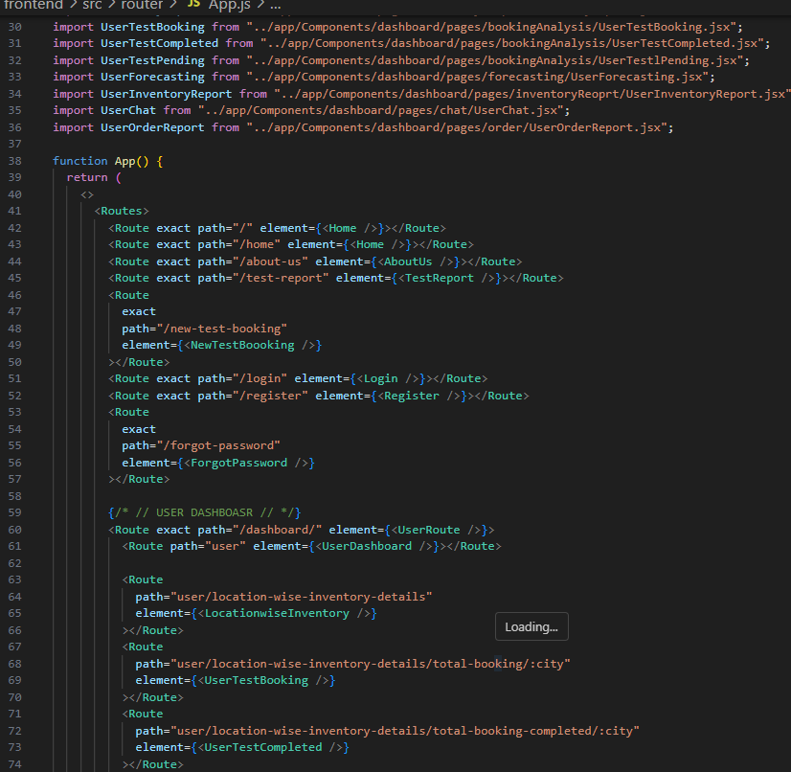
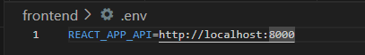
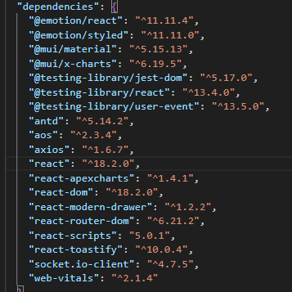
Frontend Routing
Frontend .env
Frontend Dependencies

Slide 11
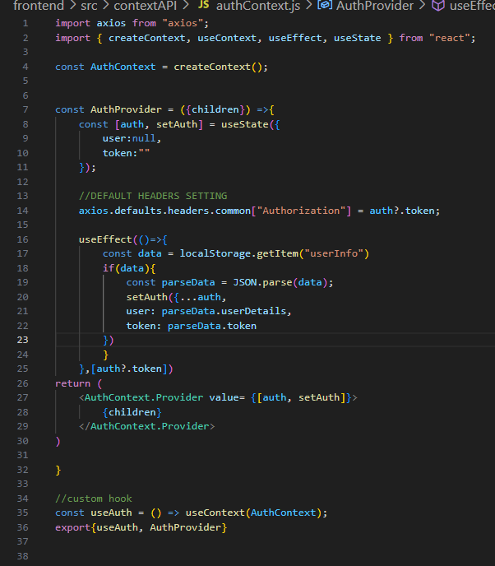
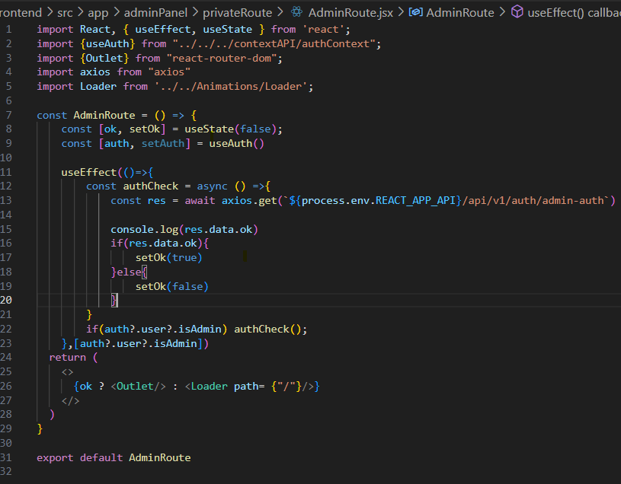
ContextApi For Global State Handling
Admin Protected Routes

Slide 12
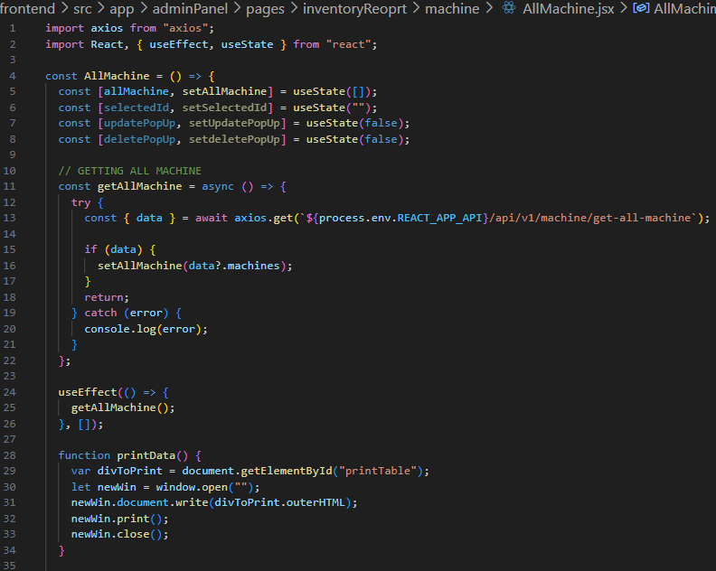
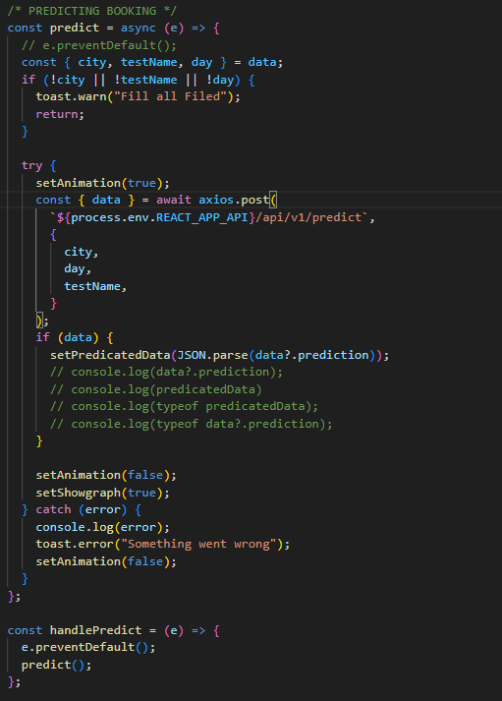
Api Handling through Axios in Frontend

Slide 13
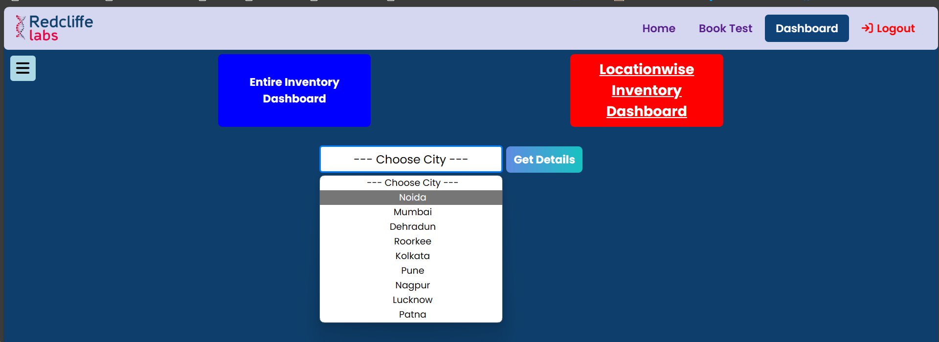
Inventory Dashboard
This interactive dashboard offers comprehensive booking details for all patients. It showcases categorized test details, monthly booking statistics, and the total revenue generated last month. Additionally, it provides location-specific booking specifics.

Slide 14
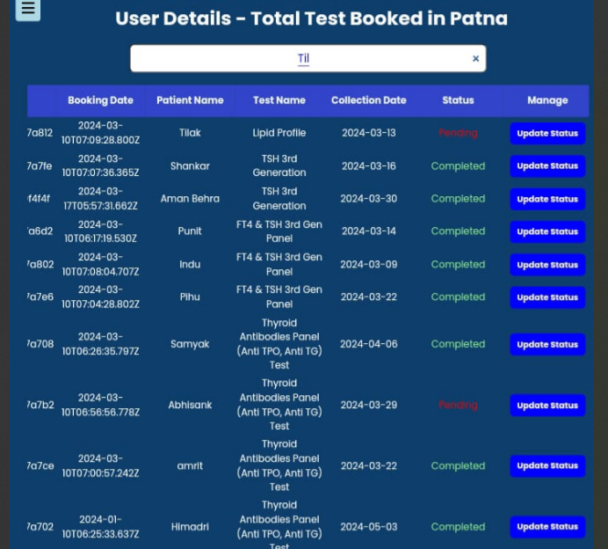
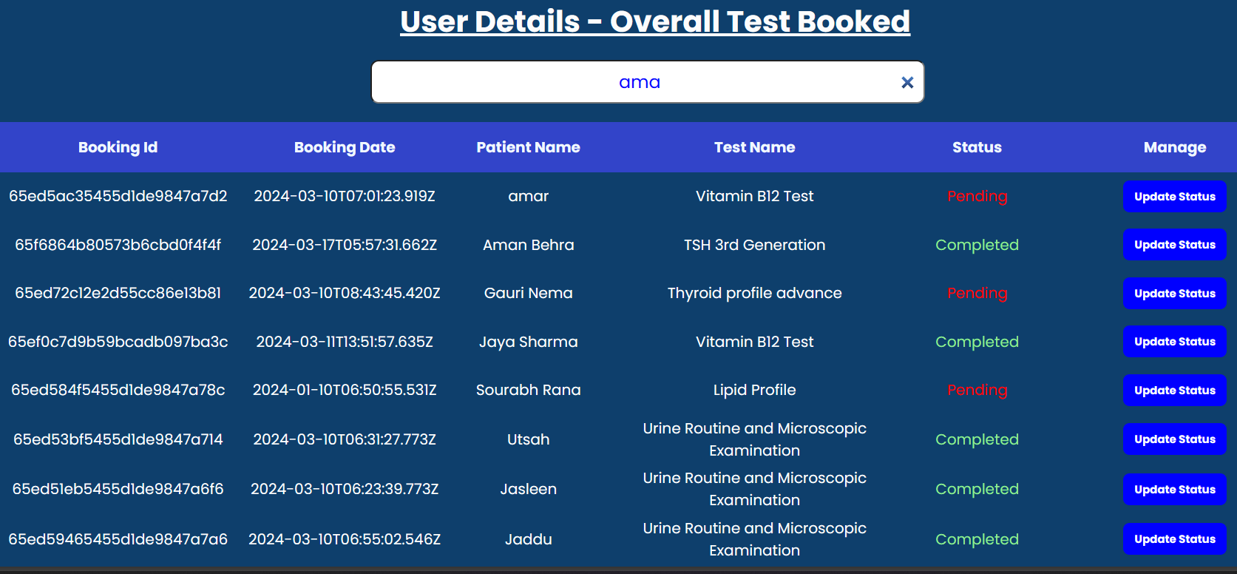
Booking ANAlysis
This feature enables users to give detailed reports on the booking of patients overall and specific location-wise. The user can update the status of the test also. Users can search for the name of the patient in the search bar.

Slide 15
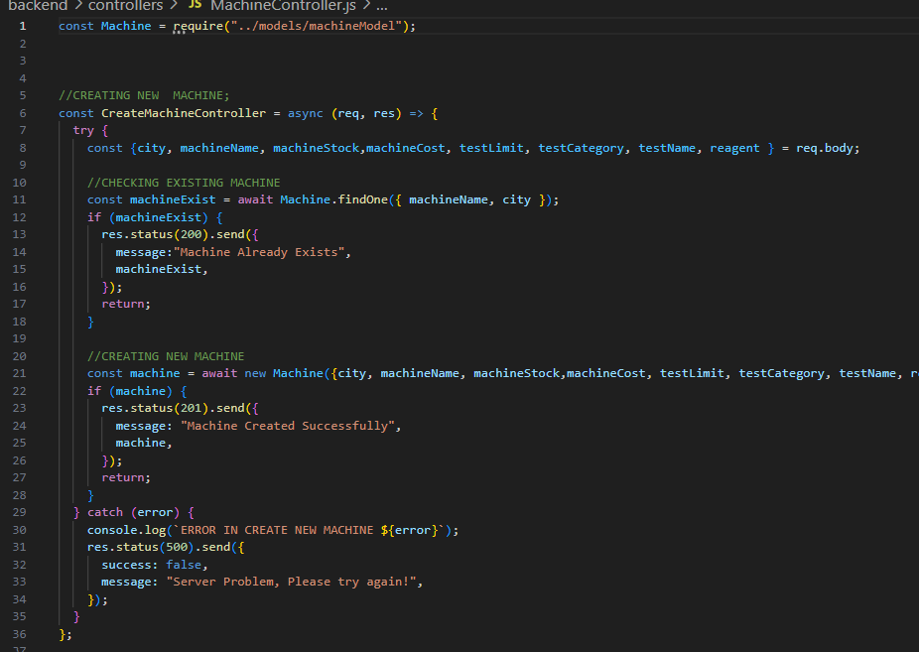
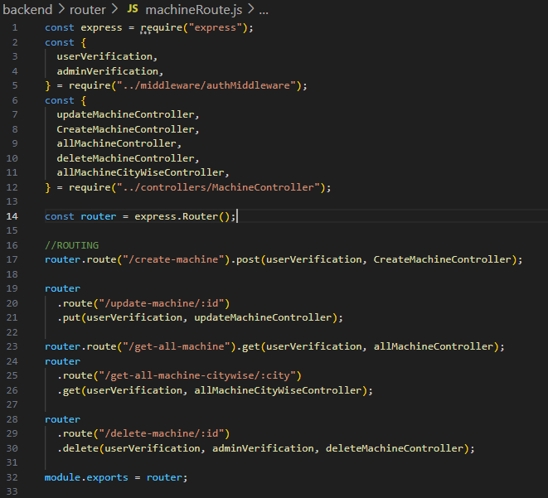
Machine Controller
Machine Routes

Slide 16
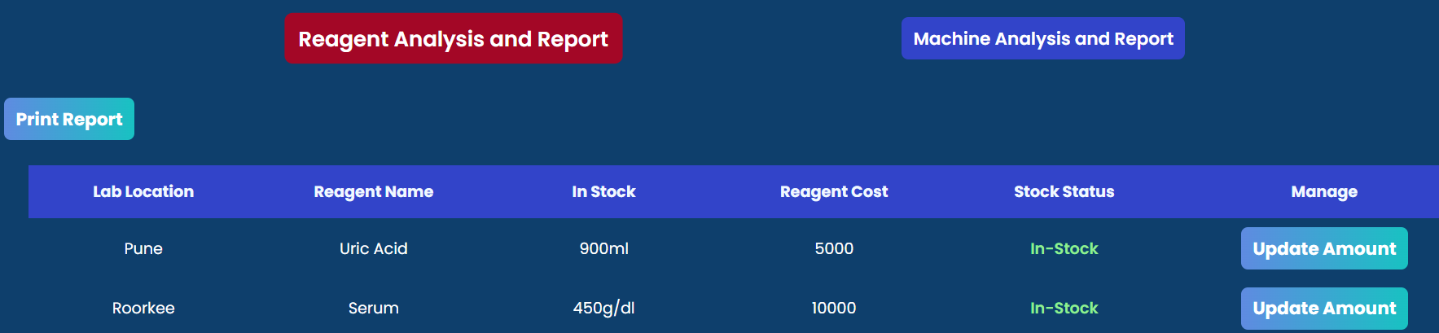
Inventory Report & Analysis
This feature allows users to analyze inventory reports for machines and reagents, providing detailed insights into stock items. It displays the current status of each item, allowing users to print reports and update reagent amounts based on the current inventory levels, with appropriate user privileges granted.

Slide 17
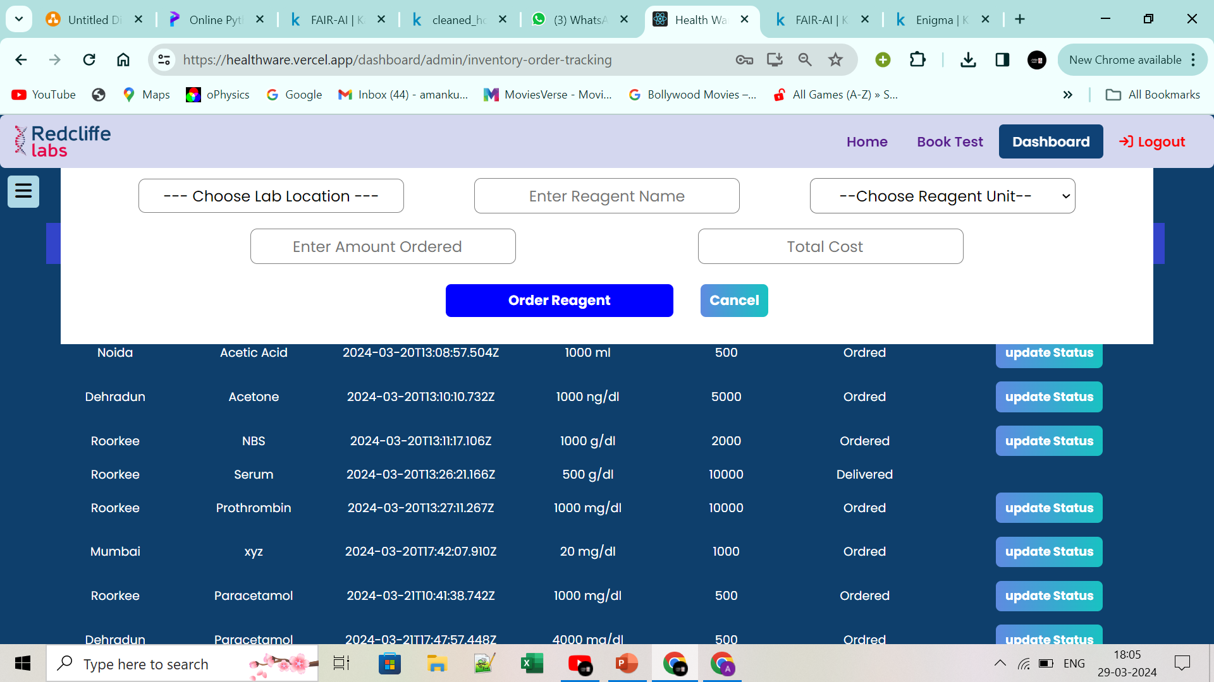
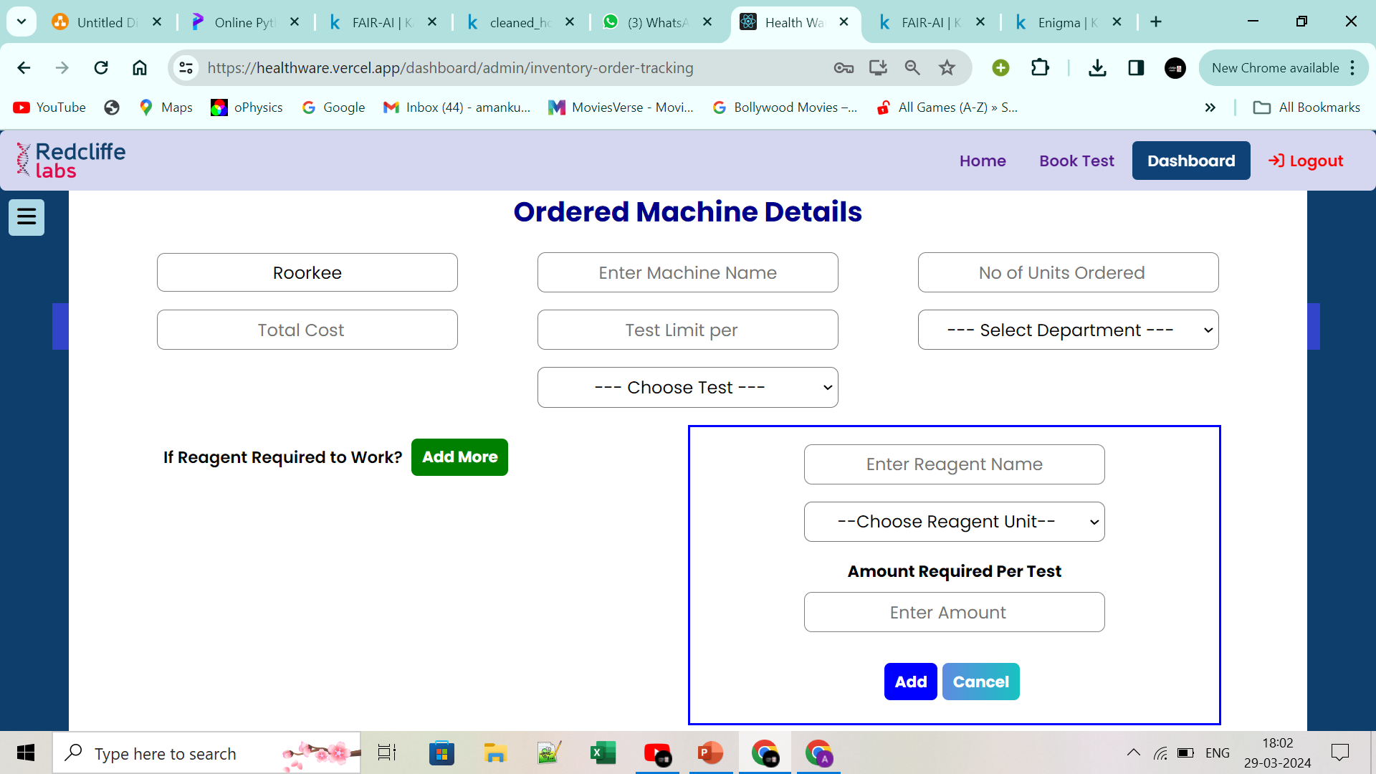
Inventory Order Tracking
With the system, users can effortlessly monitor the status of reagent and machine orders for different tests across multiple locations. The simple interface allows them to track order progress from shipping to delivery and efficiently update status.

Slide 18
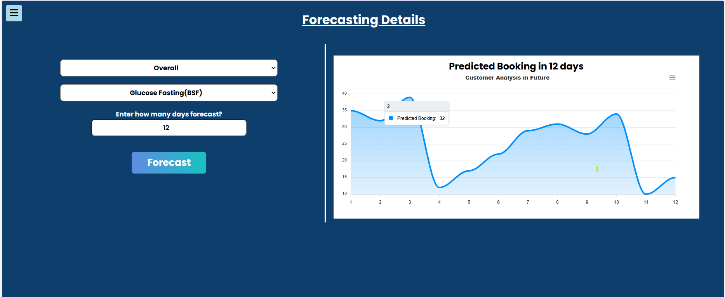
Forecasting
Predict the number of customers for a specified number of days, considering different locations and test categories. Users can input the desired forecast period, and the system generates accurate predictions with detailed plots, providing insights into customer demand trends based on location and test types.
https://github.com/Kou2004/Inventory_Forecasting

Slide 19
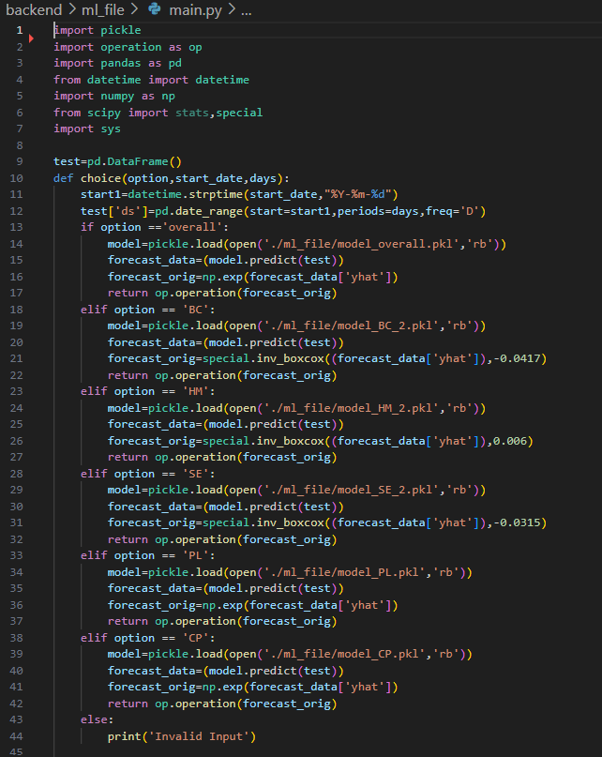
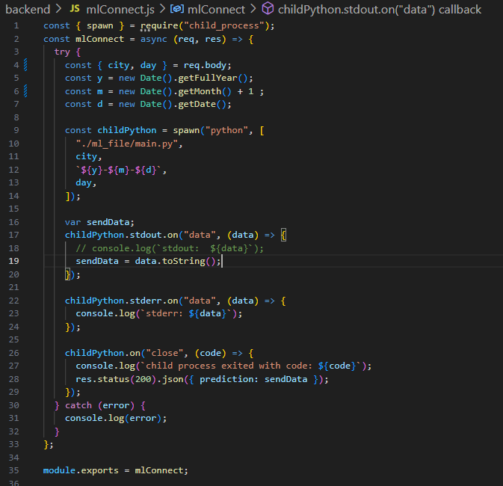
ML Main File
Connect of ML file Through Spwan Child Process

Slide 20
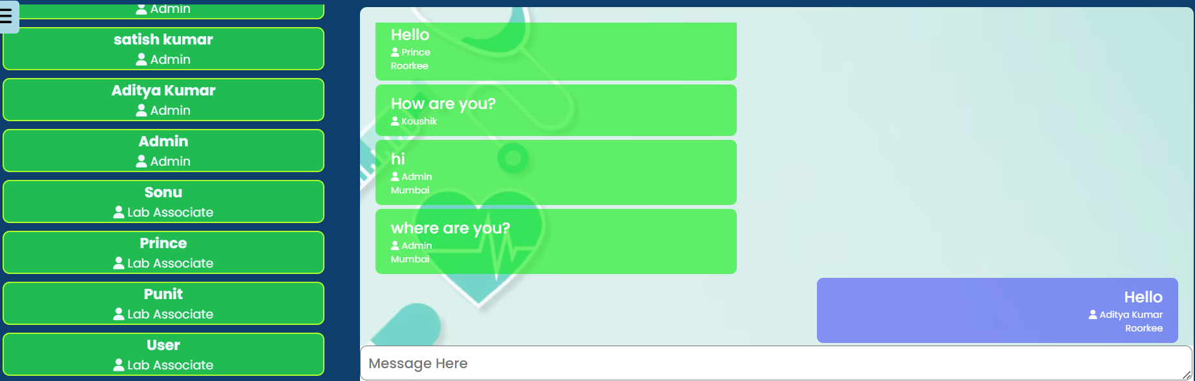
Chat Feature
This feature facilitates efficient communication between laboratory associates and admin through an interactive chat user interface (UI), streamlining communication channels to ensure seamless exchanges of information and updates between lab personnel and administrative staff.

Slide 21
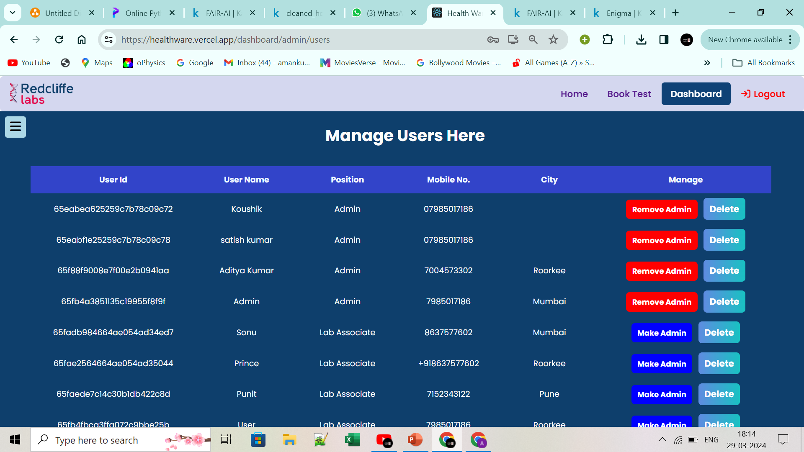
Manage Users
The admin has the power to update lab associates' information and authorize specific members to access confidential lab details. This feature ensures centralized user management, guaranteeing controlled access and security within the system.

Slide 22
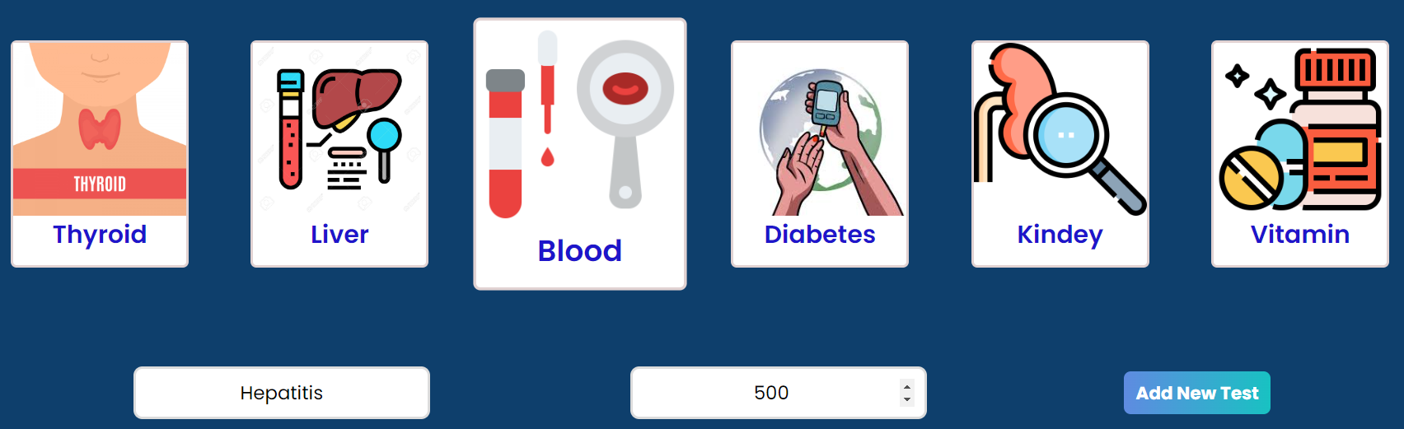
Add New TEST
This feature allows users to exclusively add new test methods. users can make the test method available and set its price accordingly

Slide 23

LAB ASSOCIATE Features :
The panel offers essential tools designed to streamline operations for lab associates within a specific location as the admin panel. These tools encompass a communication platform for real-time interaction, forecasting capabilities for predicting customer volume, real-time monitoring of inventory orders, analysis of inventory reports to provide insights into stock levels, and comprehensive booking reports to facilitate performance evaluation..

Slide 24

IMPROVEMENTS
Integration of Google Auth and Social Media Auth.
Utilize the voice feature in the chat section for more effective communication.
To enhance the accuracy of inventory demand forecasting through machine learning, ensure consistent data feeding and regular model training.
Alert Notifications for Reagent and Machine Stock Levels.
Revenue Generation and Reagent Updates based on Test Completion

Slide 25
Challenges
Dynamic Data Retrieval by Date Range: Implementing functionality to retrieve data from the backend based on dynamic date ranges, such as the current month, previous month, and months prior, presented a significant challenge.
State Management and Routing for User and Admin Interfaces.
Integration of Machine Learning Models.
Responsive Web Design for Multiple Devices.

Slide 26


GitHub Link : https://github.com/satish30118/tinkerquest
Team Terox

